Slide 1

Competitive Analysis & Market Positioning
Group 5 | Final Project
Presented By:
Kiruthika Ramadoss
Hinduja Cheela
Hari Chandana Bheemireddy
Naga Kavya Vidiyala

Slide 2


Introduction & Project Overview
Project Context
Understand McCoy’s position in the AI education landscape
Program
12-credit 'X + Applied AI' enhancement
Key Question
How McCoy school could position, this new program in a way that attracts and retains graduate students in today’s competitive market?

Slide 3
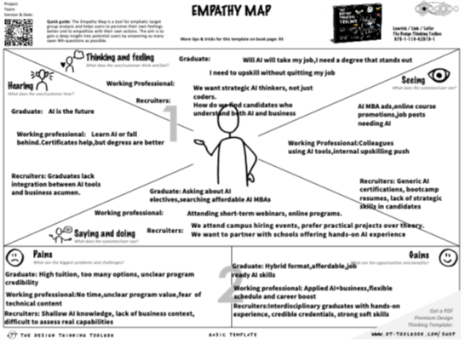
User Insights (Empathize Stage)
We Interviewed:
🧑‍🎓
💼
👨‍🏫
Graduate Students
Employers/Recruiters
Working Professionals
Key Insights:
Students want affordable, flexible, career-aligned programs with hands-on AI
Professionals need applied AI + business learning that fits their schedules
Recruiters seek strategic AI thinkers with real project experience and soft skills
.
Tools Used:
Empathy Maps – helped visualize what each user group says, thinks, does, and feels

Slide 4




Competitive Landscape Analysis
Key Points:
🌐
Conducted a comprehensive scan of both direct and indirect competitors
✅
Identified strategic market gaps and white space opportunities
🧭 Tools Used:
Competitor Feature Matrix
Comparative Branding Audit
2x2 Positioning Map

Slide 5





Direct Competitor Analysis
Programs Studied:
Northwestern MBAi, Drexel MBAi and similar graduate business AI programs
Key Evaluation Dimensions:
📘 Curriculum Structure
🧑‍🏫 Delivery Format
and depth of AI integration
(online, hybrid, in-person)
💬 Branding & Messaging
💼 Career Placement Success
strategies
👨‍🎓 Alumni Profiles
and employer networks

Slide 6

Indirect Competitor Analysis
Types of Indirect Competitors Reviewed:
🌐
Online Platforms (Coursera, edX):
✅
Affordable and flexible
❌
Lack academic credibility and cohort experience
🏢
Corporate Training Programs:
✅
Tailored to specific skills
❌
Not transferable or strategic in scope
🚀
Bootcamps & Intensives:
✅
Focused on technical AI skills
❌
Weak in leadership and business strategy integration
🏛️
Industry Associations:
✅
Offer certifications
❌
Lack structured academic progression

Slide 7

Competitor Feature Matrix
WHAT IT IS:
A table comparing key program features across competitors to identify strengths,
weaknesses & gaps
Feature
McCoy X+AI
Drexel MBAi
Coursera AI
Springboard
AI Integration Depth
High
High
Low
Medium
Business Context Focus
Strong
Strong
Weak
Medium
Program Cost
Medium
High
Low
Medium
Delivery Mode
Hybrid
In-person + Online
Online
Online
Target Audience
Broad
MBA-level
Beginners
Career switchers
Career Support / Placement
Moderate
Strong
Weak
Moderate
Credibility (Academic Rigor)
High
High
Low
Medium

Slide 8



How This Helped:
Identified
white space
where McCoy stands out →
"High AI + Business
Focus + Low Cost"
Supported McCoy's position in the
2x2 Positioning Map
Informed strategic recommendation by highlighting
McCoy's unique
combination

Slide 9

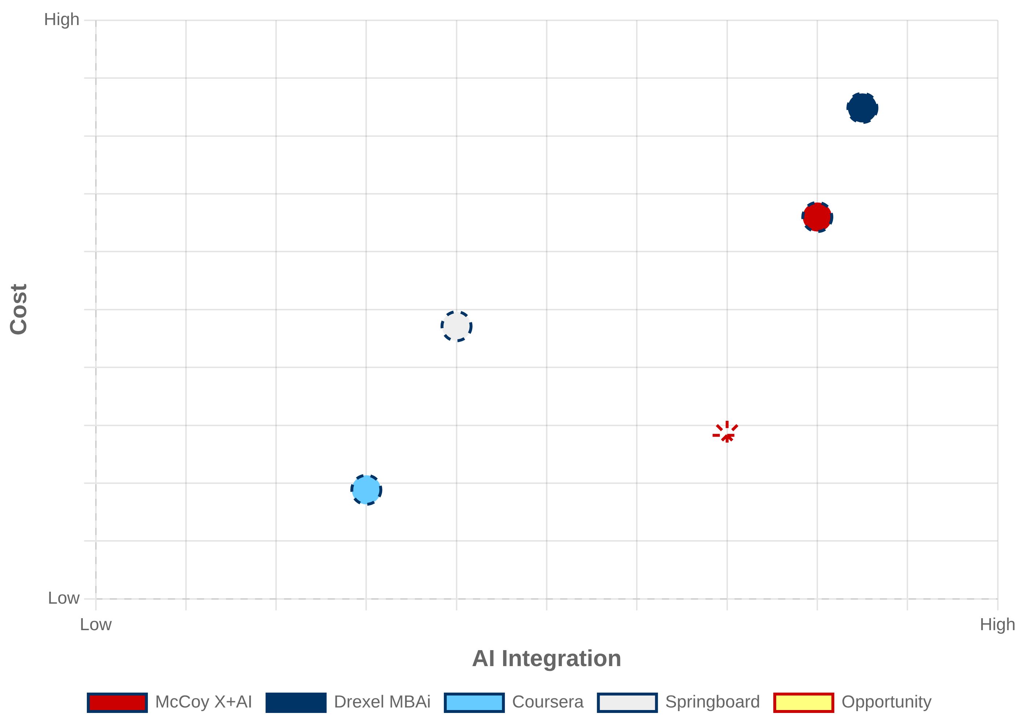
Positioning Map (2x2)
Axes:
X-Axis:
Low → High AI Integration
Y-Axis:
Low → High Cost
🔝
Top Right (High AI, High Cost):
• Drexel
MBAi
• McCoy X+AI
🔙
Bottom Left (Low AI, Low Cost):
• Coursera
⬅️
Middle Left (Low AI, Mid Cost):
• Springboard
⚠️
Bottom Right (High AI, Low Cost):
• Opportunity — No major competitor
🎯 Takeaway:
McCoy is well-positioned as a credible and AI-rich
academic program. But compared to online platforms, its
cost is higher.
Strategic recommendation:
Maintain high AI relevance
while balancing affordability to stand out even more

Slide 10

Comparative Branding Audit
A qualitative review of how top competitors present their ​branding​, visuals, tone and value messaging
Attribute
Drexel MBAi
Coursera AI
McCoy X + AI
Tagline
"Ambition Can’t wait"
"Learn AI Online"
"Business meets AI – Affordably"
Website Look/Feel
Corporate, professional
Simple, accessible
Modern, academic
Tone
Elite, future-ready
Casual, skills-focused
Practical, balanced
Visual Identity
Blue/Gold, formal imagery
Flat icons, white BG
Red/Navy, real classrooms
Outcome Emphasis
Salary, MBA network
Skill certificates
Business-focused AI application

Slide 11







Ideation Process
Objective:
Transform user insights and competitor analysis into creative, high-impact solutions for McCoy's X + Applied AI.
Gaps Identified:
Elite MBA programs
(Drexel, Northwestern): Too expensive, inflexible
Online certifications
(Coursera, edX): Affordable but lack academic depth, recognition, and cohort feel
Bootcamps
Strong in tech skills but miss business + leadership integration
Tools Used in Ideation:
SCAMPER Method
Brainwriting & Team Pooling
Value Proposition Canvas

Slide 12
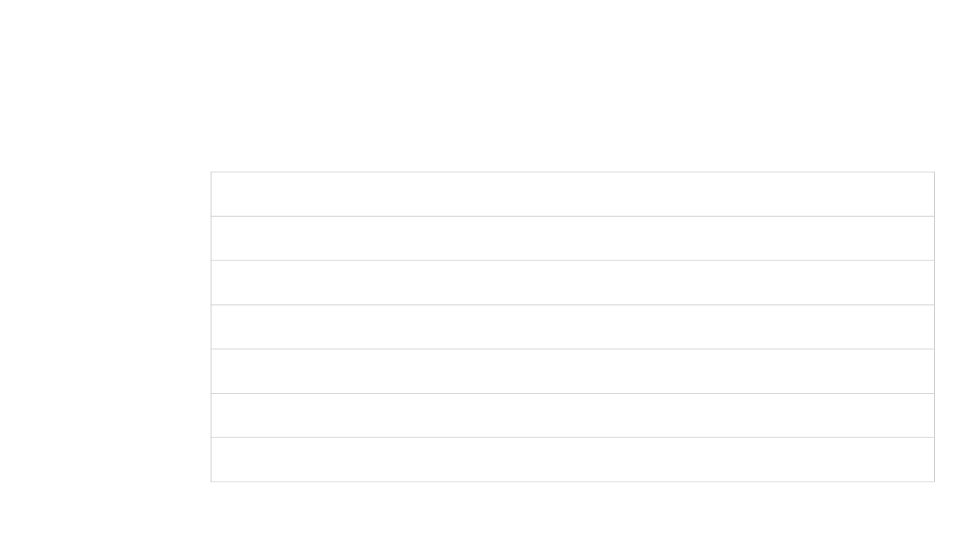
1.SCAMPER METHOD
We applied the SCAMPER framework to reimagine how McCoy's program could stand apart
Action
McCoy Application
Replace generic electives with applied AI modules
S
ubstitute
AI + Domain-specific business use cases
C
ombine
Flexible hybrid delivery for working professionals
A
dapt
"Texas-rooted AI leadership" branding
M
odify
CADS labs + real-world AI case projects
P
ut to Use
Outdated lectures → simulations
E
liminate
Modular, stackable micro-credentials
R
earrange

Slide 13

2.Brainwriting & Team Pooling
Rather than debating ideas aloud, each team member independently wrote down 3–5 positioning concepts. Then, we rotated and built upon each other's ideas. This helped us:
Avoid groupthink
Generate diverse solutions
Rapidly refine themes
Independent ideation before discussion prevented dominant voices from steering the direction
Focused on accessibility, business relevance, and Texas branding
Multiple perspectives led to original and innovative positioning concepts
Individual Ideation
(3-5 concepts each)
Rotation & Building
(Add to others ideas)
Theme Identification
(Find patterns)

Slide 14
3.Value Proposition Canvas

Slide 15

Outcome of Ideation Phase:
We focused our solution around:
Regional credibility and affordability
Business-first AI education
Flexible delivery for busy professionals
These ideas became the basis for:
Our taglines
Landing page prototype
Landing page wireframe
McCoy's strategic position: "The most accessible, applied AI business program in Texas."

Slide 16
Prototype Development
We developed multiple low-fidelity prototypes to visualize McCoy's market identity.
1.Taglines
Purpose:
To communicate the core value of the program in a memorable, emotional, and strategic way
Why it matters:
Taglines create instant recall and brand identity
Helps differentiate McCoy from other AI programs
Sets the tone for marketing materials and websites
Examples:
"AI for Business. Applied to You." → Focuses on personalization and practicality
"Business Ready. AI Smart." → Emphasizes dual strengths in business and AI
"Real AI. Real Business. Real Texas." → Adds local/regional identity to credibility

Slide 17

2. Program One-Pager
Purpose:
To give a quick, clear, and visual summary of the program - like a brochure that informs a
convinces in one page.
.
Why it matters:
Accessibility
Shareability
Clarity
Useful for recruiters, students, and advisors
Easy to share digitally or in meetings
Makes complex program elements easy to understand
Key Elements:
Program overview with clear value proposition
Visual representation of the 4-pillar curriculum
Key differentiators highlighted with icons
Contact information and next steps for interested parties

Slide 18
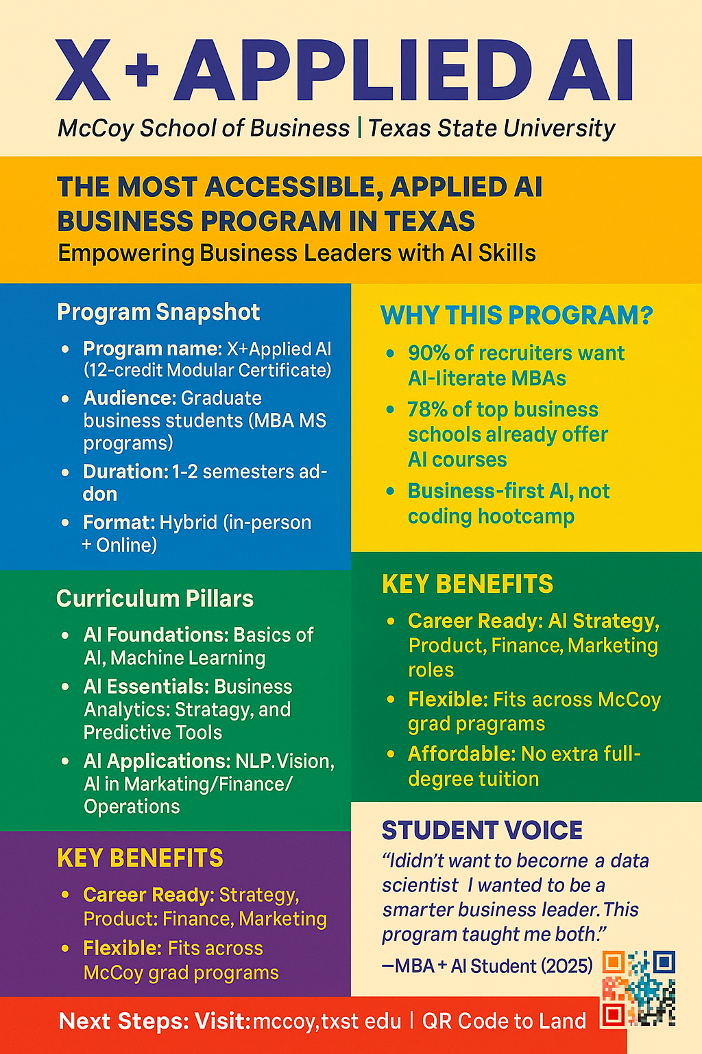

Slide 19
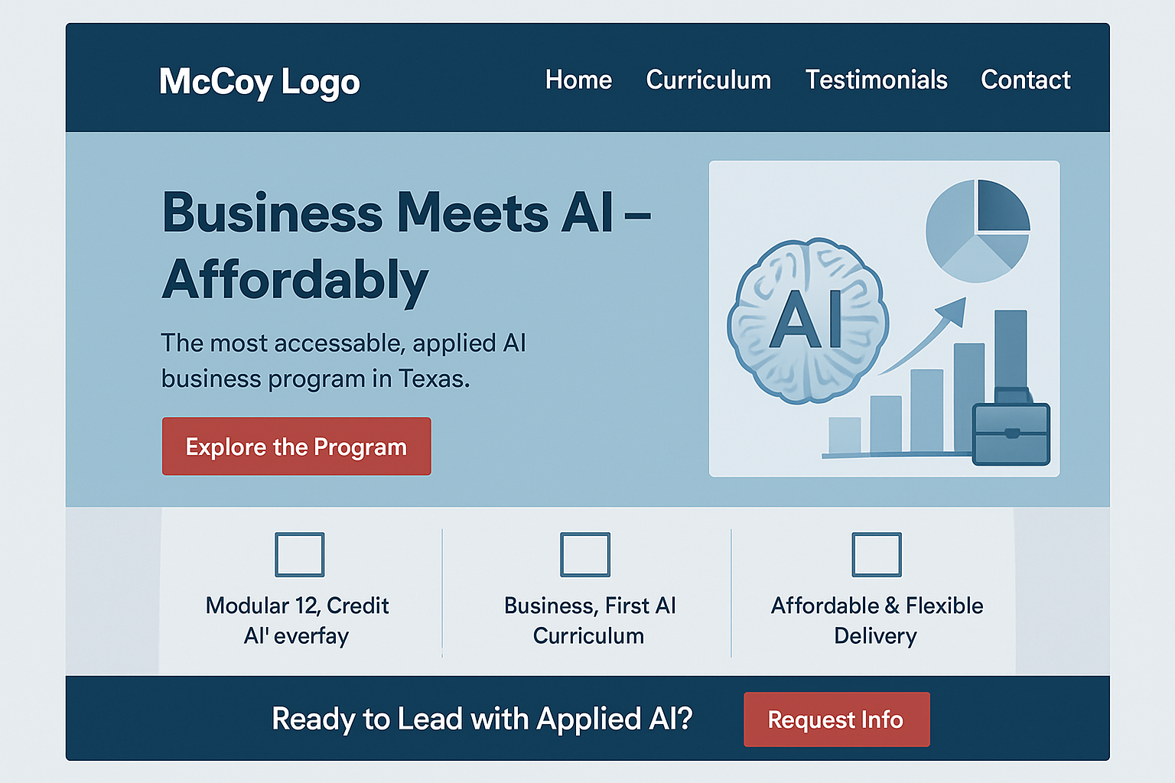
3. Landing Page Wireframe
Purpose:
To visualize what the actual website page for
McCoy’s program might look like.
l
Why it matters:
Helps stakeholders imagine implementation
Guides future web development
Shows storytelling and visuals working together

Slide 20
Testing & Feedback
We tested prototypes with:
6 Graduate students
3 Working Professionals
2 Recruiters

Slide 21




Final Solution
,
"The most accessible, applied AI business program in Texas" — blending affordability real-world AI, and business strategy.
.
Key Differentiators:
Modular AI Overlay:
12-credit add-on to MBA/MS programs → flexible & customizable
4-Pillar Curriculum:
AI Basics
Strategic AI Applications
Domain-Specific Integration
Real-World Capstone
Texas Brand + National Reach:
Local credibility, scalable beyond Texas
Built for Working Professionals:
Hybrid format, business-focused, practical and not overly technical

Slide 22

Thank You!

